Slide 1

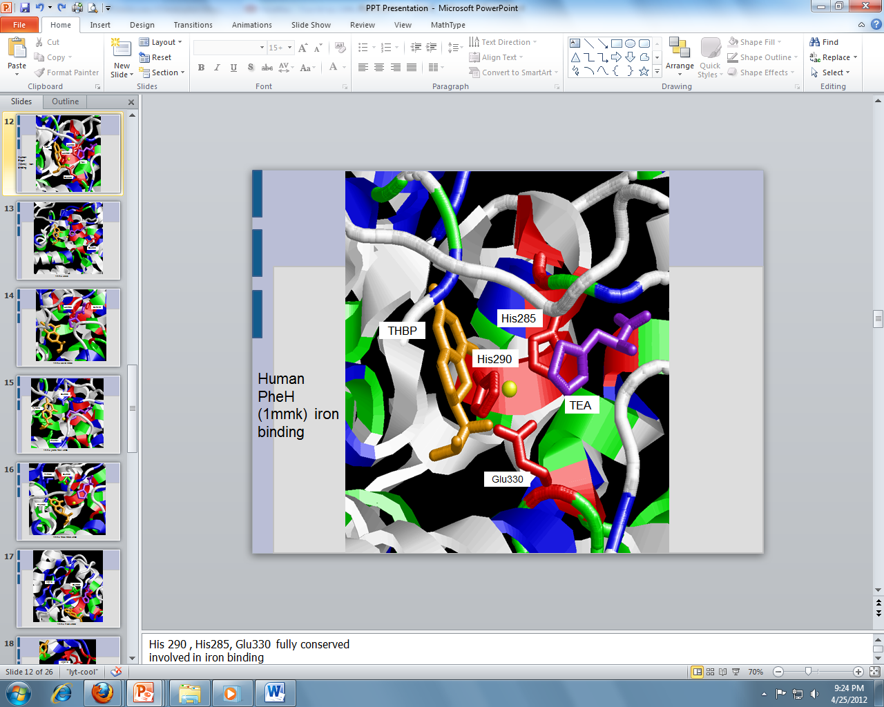
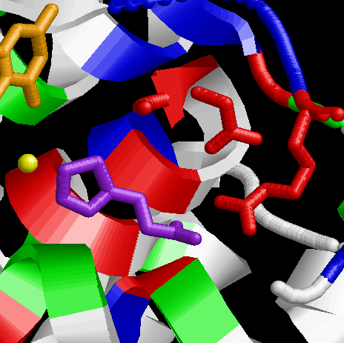
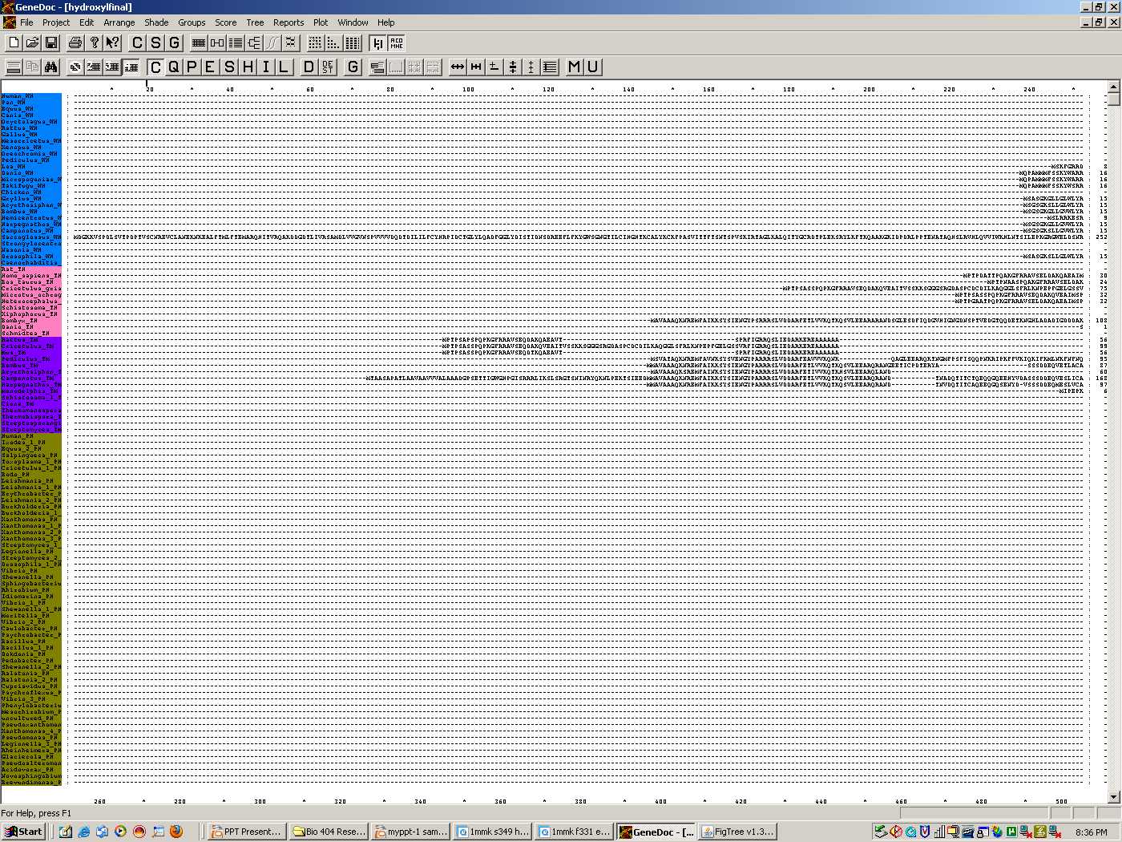
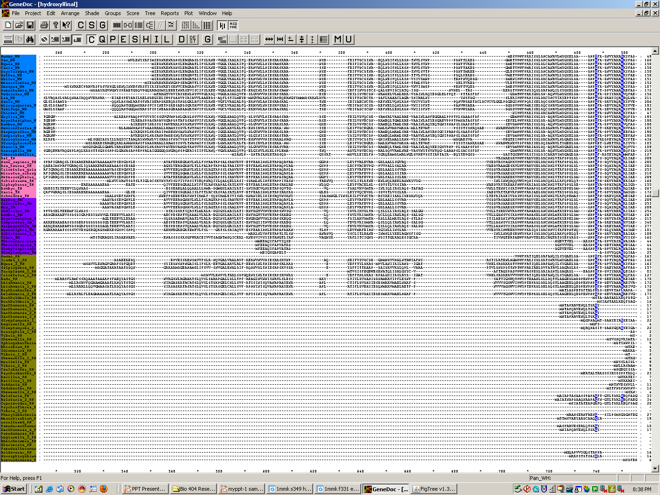
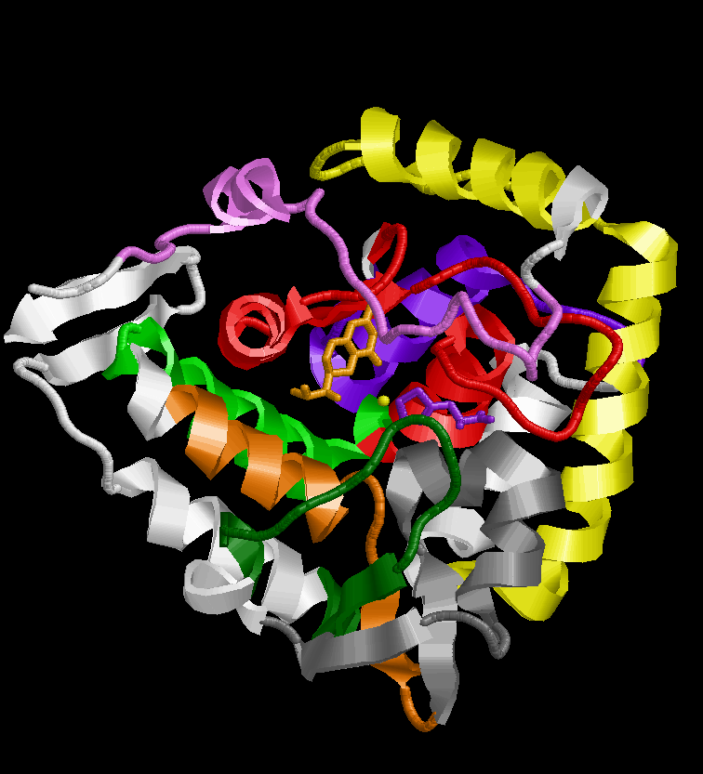
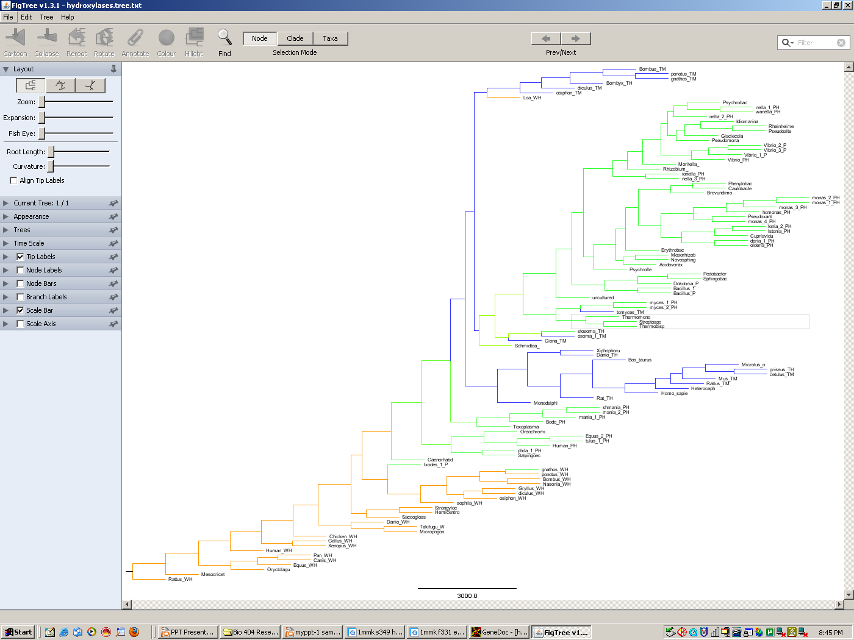
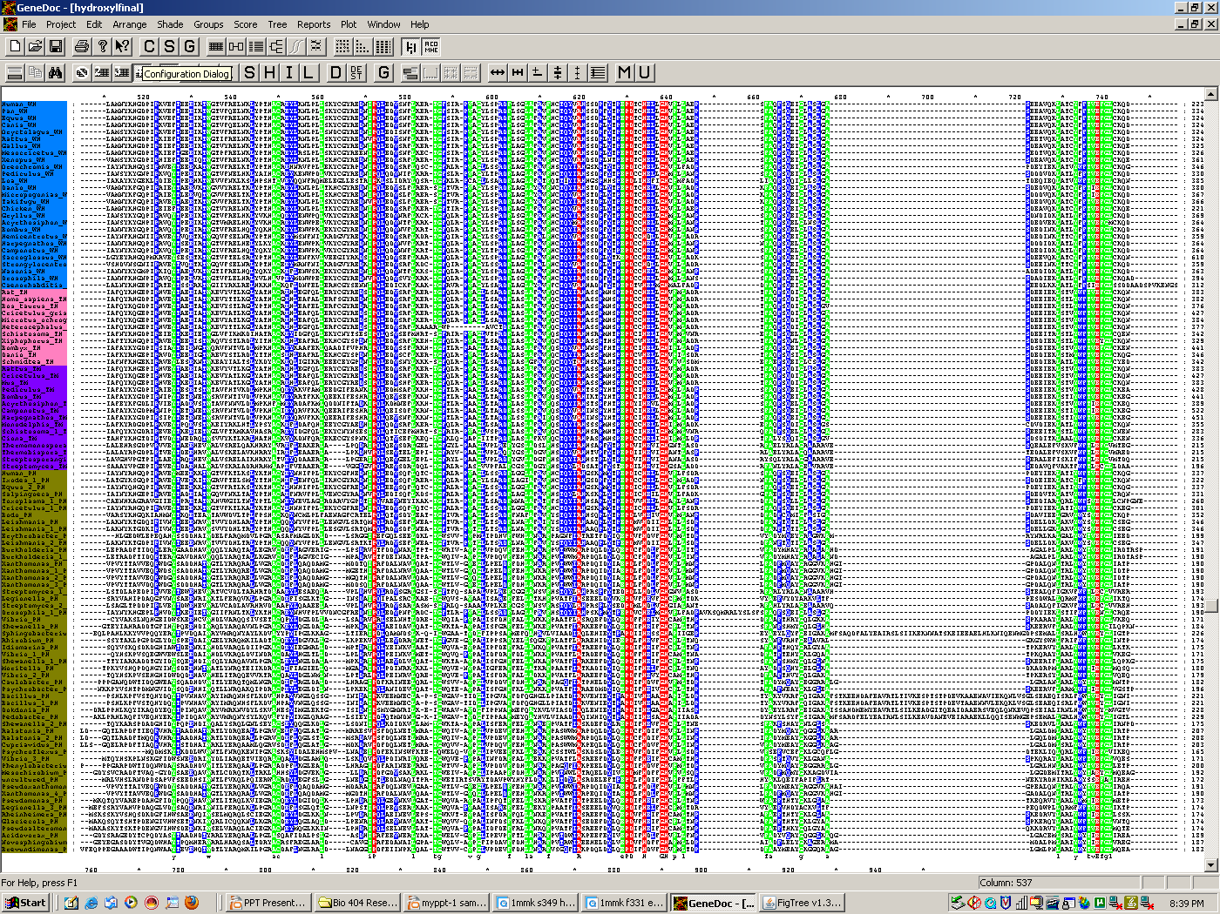
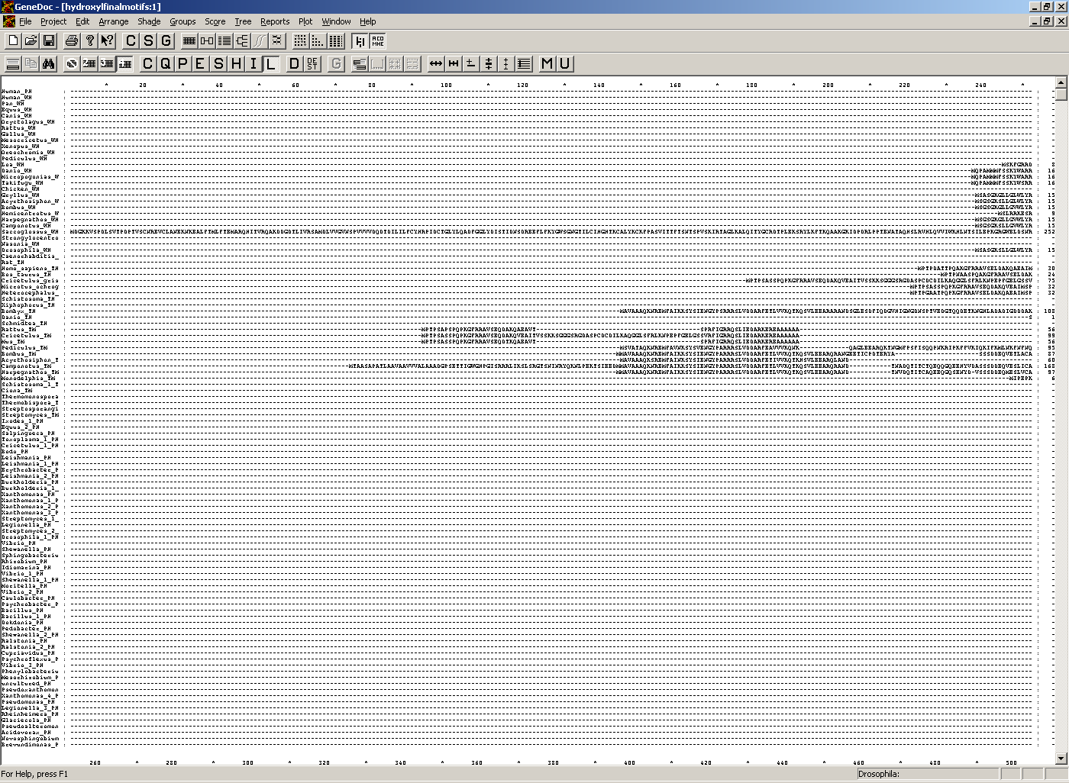
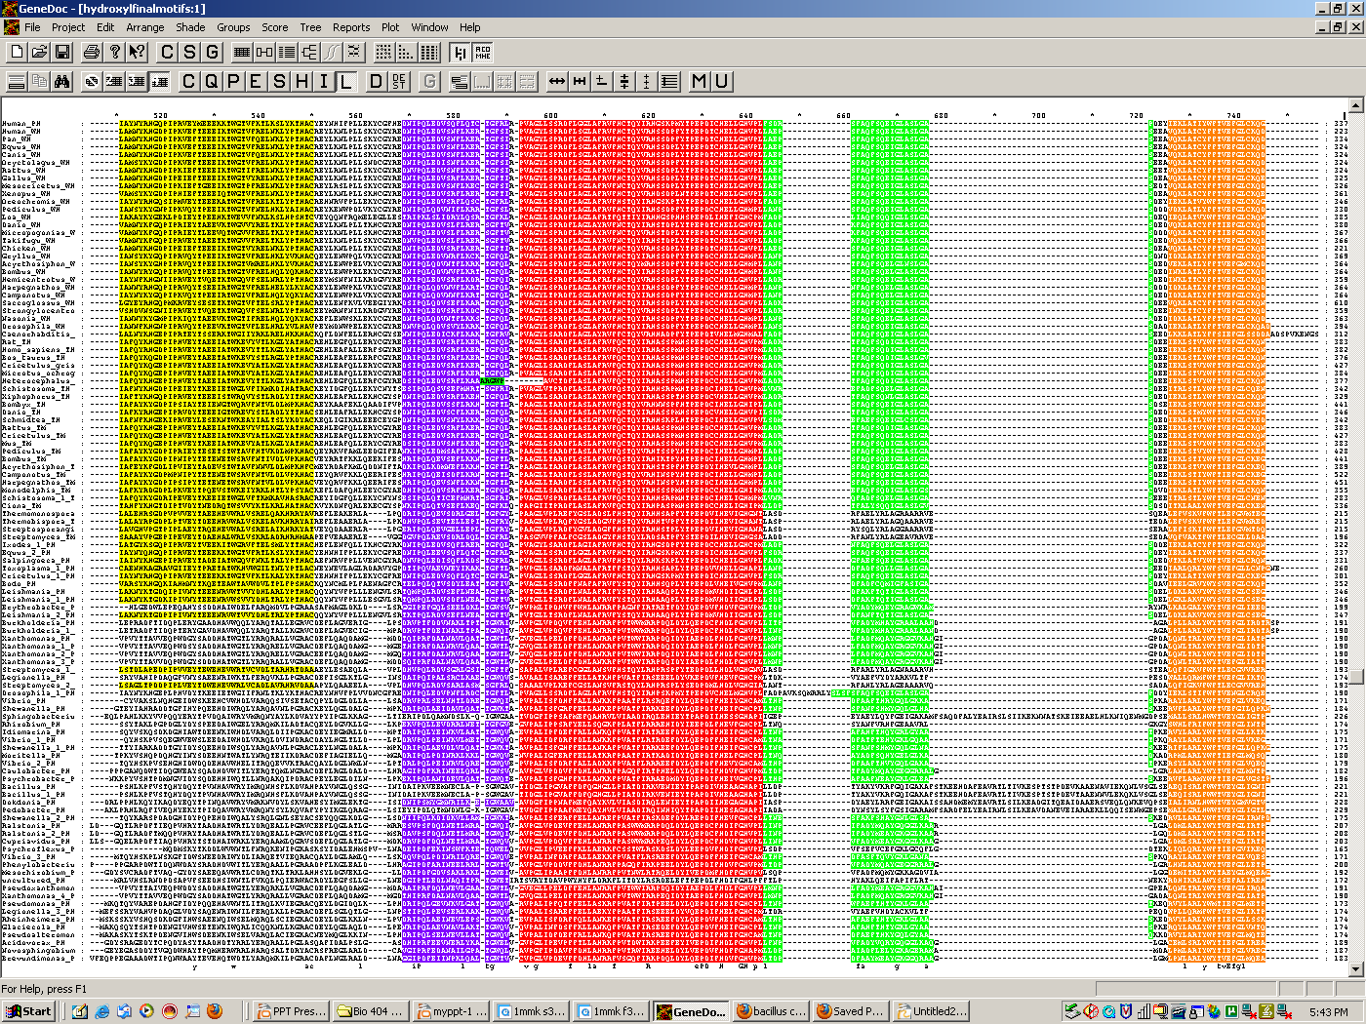
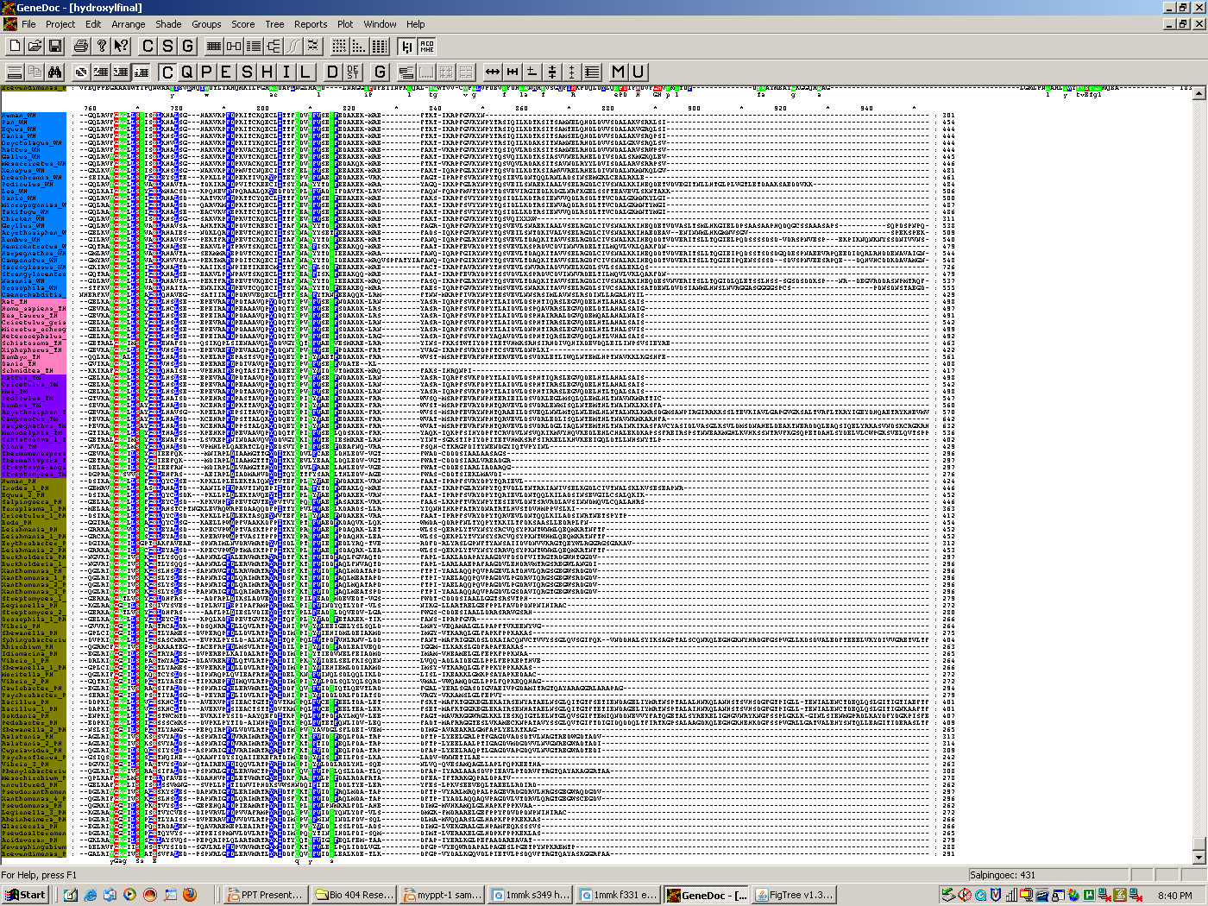
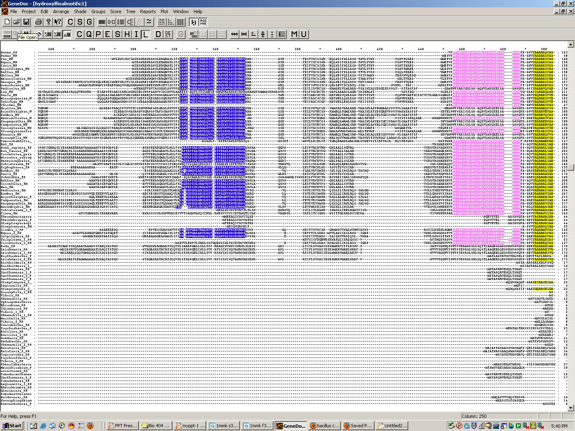
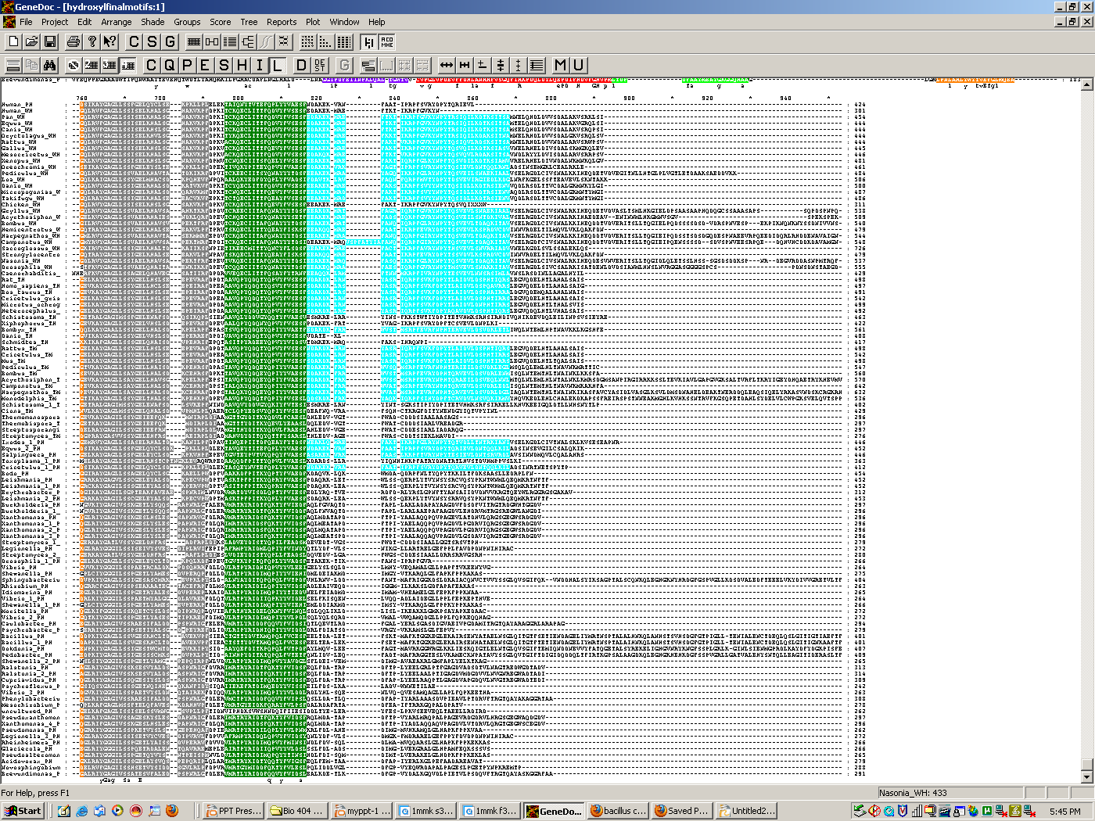
Comparative Analysis of the Aromatic Amino Acid Hydroxylase Family
Christopher Maguire & John Perozich
Department of Biology, Franciscan University of Steubenville, Steubenville, OH.
INTRODUCTION
FIGURE 2
Aromatic amino acids are a family of closely related proteins involved in metabolizing amino acids that have an aromatic ring [1]. Tyrosine, phenylalanine, tryptophan hydroxylase and tyrosine monooxygenases were examined for conservation. Tryptophan hydroxylase catalyzes the first step in the synthesis of serotonin, the hydroxylation of tryptophan to 5-hydroxytryptophan (5-HTP) [2]. Phenylalanine hydroxylase helps convert excess phenylalanine in the diet to tyrosine [3]. Tyrosine hydroxylase converts tyrosine to L-DOPA , a precursor for catecholamines [2].
The goal of this undergraduate research project was to compare the amino acid sequences of three aromatic amino acid hydroxylases from a variety of organisms and look for structural, functional and phylogenetic relationships.
Figure 2
FIGURE 6
Cys-14
Glu-9
Asp282
Asn-134
His-119
Arg270
FIGURE 1
Leu-84
Tryptophan Hydroxylases
Figure 6: Location of Aspartic Acid 282 and Arginine 270 , invariantly conserved and form a salt bridge with each other. Arg 270 is 3 angstroms from the carboxyl group of TEA (purple) and there is likely some interaction. Asp 282 is also close to TEA and its amino group may interact with the inhibitor.
Tyrosine Hydroxylases
Figure 2: Human Phenylalanine hydroxlase (1mmk) [1] is shown above. His 290, His 285, Glu 330 are 100% conserved and help bind iron (yellow). THBP, tetrahydrobiopterin (golden) is bound as a co factor. TEA, thienylalanine (purple) binds close to the active site due to its similarities in structure t o phenylalanine.
Tyrosine Monooxygenases
Phenylalanine Hydroxylases
FIGURE 3
FIGURE 7
Leu-89
Tyrosine Hydroxylases
Phe-28
Gly-25
Trp-87
Phenylalanine Hydroxylases
Tyr-27
Figure 3: Human Phenylalanine hydroxylase (1mmk) [1] structure colored with the conserved motifs from pattern analysis by MEME. The red motif is the most conserved and represents the active site.
Tryptophan Hydroxylases
Figure 7: Bootstrapped phylogenetic tree of the Hydroxylases generated by the PHYLIP programs from the alignment.
Glu-26
FIGURE 4
CONCLUSIONS
Asn-20
Hydroxylases are conserved across species. 94 residues have above 60% conservation.
Most of the invariantly conserved residues are found on the interior cleft which surround the iron, and THBP molecules.
H-290, H-285 and E-330 were found to participate in iron binding.
R-270 and D-282 form a salt bridge and may interact with the TEA inhibitor.
Conserved residues have various critical roles to the structure and function of the protein.
LITERATURE CITED
1. Erlandsen et al. Crystal Structure of the Catalytic domain of Human Phenylalanine hydroxylase reveals the structural basis for Phenketonuria. Nature Structural Biology vol 4, No 12:995-1000 (1997)
2. .Fitzpatrick P.F.Mechanism of Aromatic Amino Acid Hydroxylation. Biochemistry 42: 14083–14091.(2008)
3. Fusetti et al...Structure of Tetrameric Human Phenylalanine Hydroxylase and Its Implications for Phenylketonuria. Journal of Biological Chemistry Vol 273,No 27:16962-16967 (1998)
His-17
Figure 1: Alignment of 108 sequences of Hydroxylases from a variety of organisms generated by the T-Coffee program with subsequent manual adjustment. Red-shaded residues indicate 100% conservation across species, green 80-99%, and blue 60-79%. These residue colors are continued in Figures 2,6. Sequence names are grouped and color coded: Tryptophan Hydroxylases (blue), Tyrosine Hydroxylases (pink), Tyrosine Monoxygenases (purple), Phenylalanine Hydroxylase (olive green). The eleven invariant residues are S-349, P-281, G-289, G-344, H-285, H-290, E-330, P-225, R-270, D-282, and E-353.
Ser-135
Figure 4: Pattern analysis by MEME of the alignment of the Hydroxylase proteins showing the positions of the ten most-well conserved sequence motifs. The red block is the most conserved followed by orange, yellow, grey, purple and pink being the least conserved motif.

